Slide 1



ITI SIMULATION
LARANA, INC.
OUR TEAM
Mohammed Afifi
Ahmed Hassan Ateya
Kirolos Magdy

Slide 2

AGENDA
Project Overview
Database
Reports
Dashboards
Desktop App

Slide 3

PROJECT OVERVIEW

Slide 4

PROJECT OBJECTIVE
Creating a full scale system that maps many features of ITI and simulates the student's journey, with efficient and realistic examination system.

Slide 5



KEY FEATURES
A repository for ITI's data including information about applicants, students, graduates, employees, tracks, courses and branches.
Generating exams for each course and automatically storing and correcting the results.
Creating reports using SSRS and MS PowerBI to indicate performance and forecast incoming changes.
Developing a GUI that helps the user to interact easily with the system features.

Slide 6

Requirement Analysis & system scenario
Desktop App
ERD
PROJECT LIFECYCLE
PowerBI
Mapping
Reports-SSRS
Database Creation
Stored Procedure

Slide 7
DATABASE

Slide 8
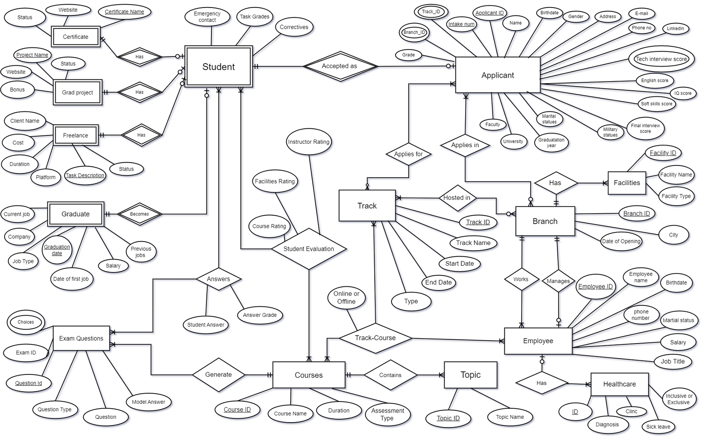
ERD

Slide 9
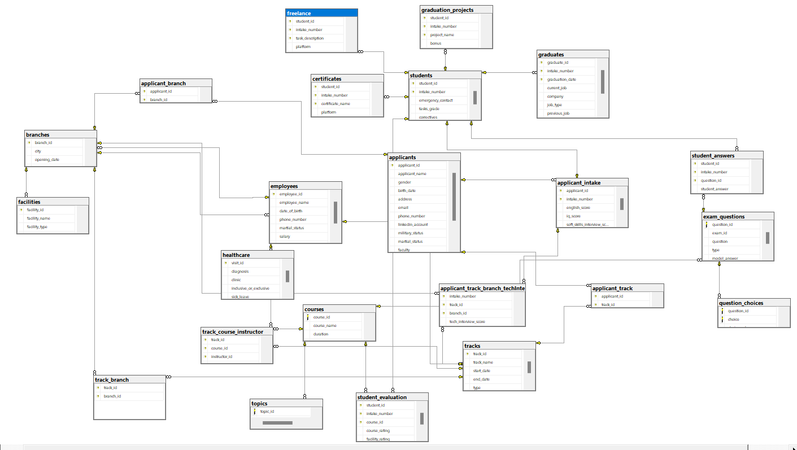
Database Diagram

Slide 10

DATA PREPARATION
The data were generated randomly using Red Gate.
However, we took in consideration generating data with realistic characteristics as long as possible.

Slide 11


STORED PROCEDURE

Slide 12
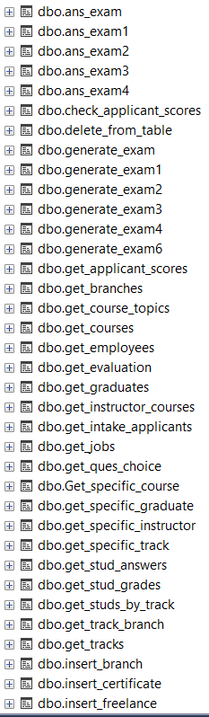
Stored procedures for insertions and selections in all tables in the database

Slide 13
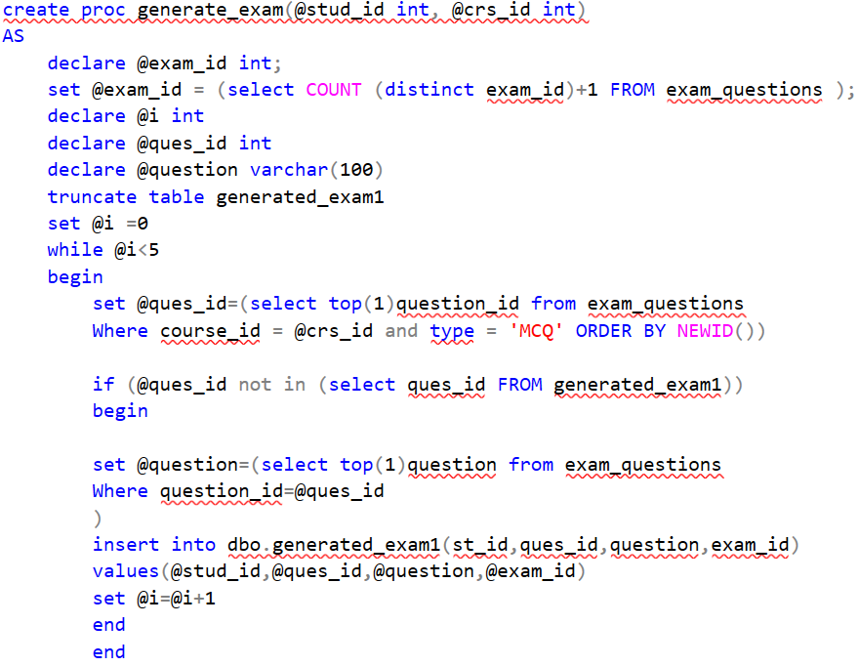
Stored procedure for generating exam

Slide 14
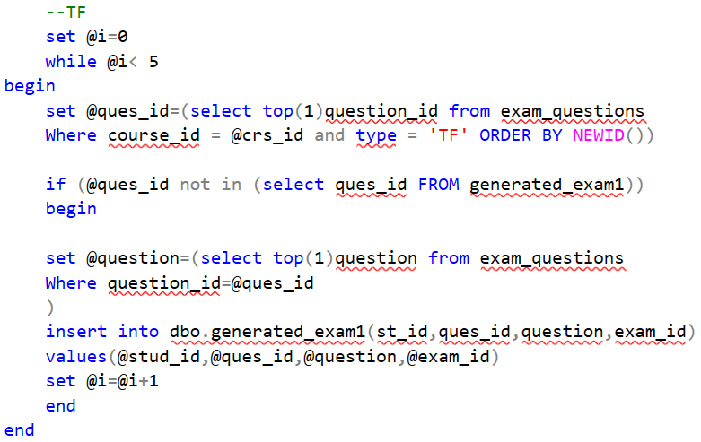
Stored procedure for generating exam

Slide 15
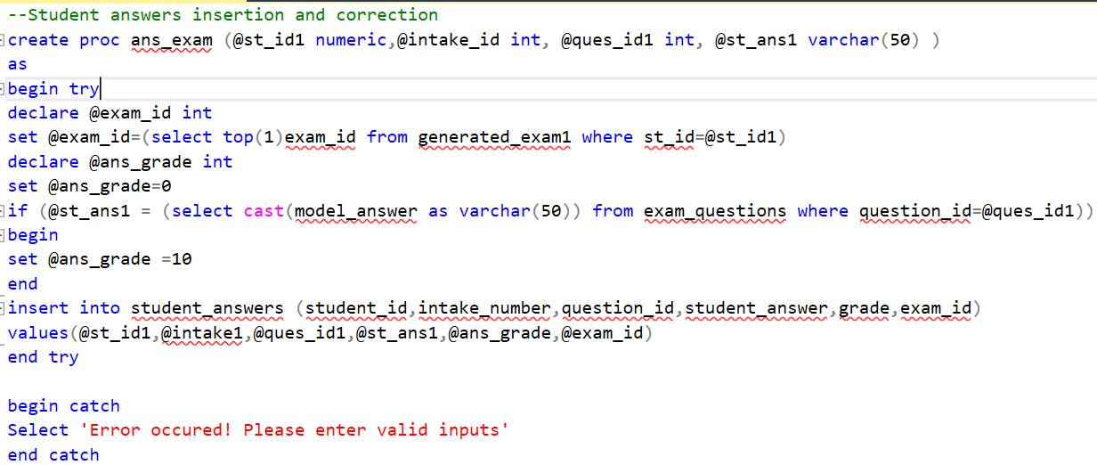
Stored procedure for exam correction and insertion

Slide 16
REPORTS

Slide 17
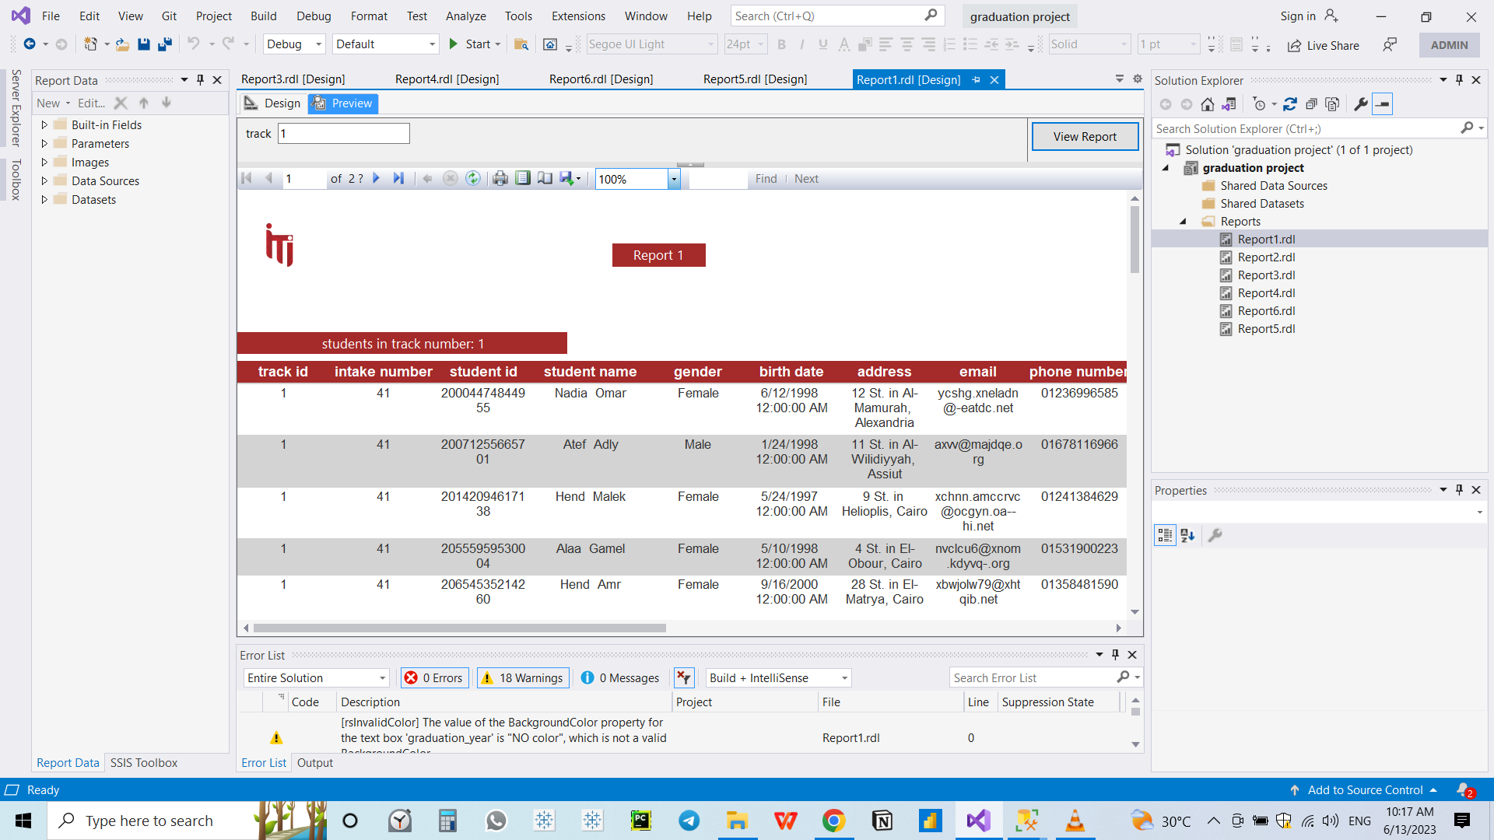
ٍStudent Per Track Report
Using track ID this report display the information of the students in the chosen track

Slide 18
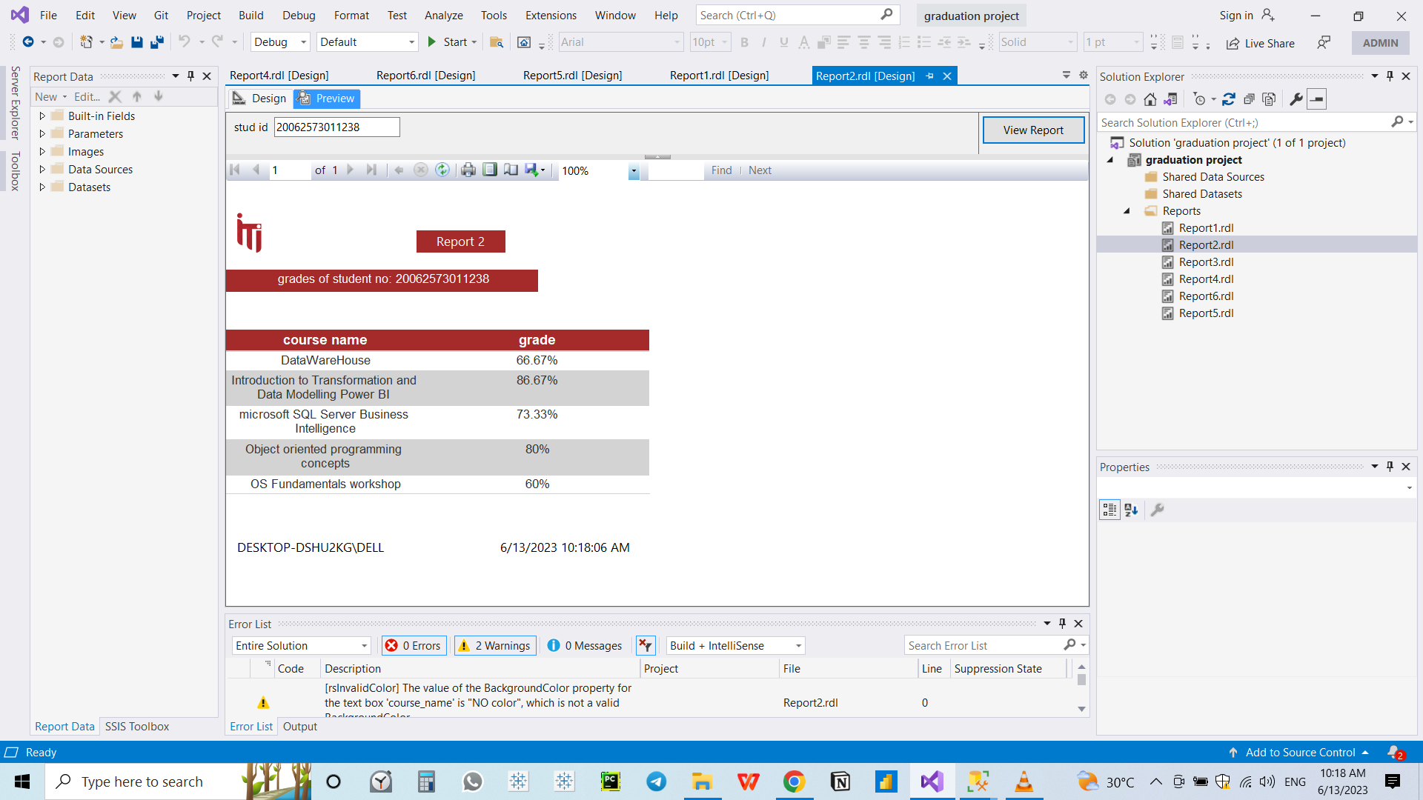
Grade By Course
Using Student ID this report display the percentage grade for each course

Slide 19
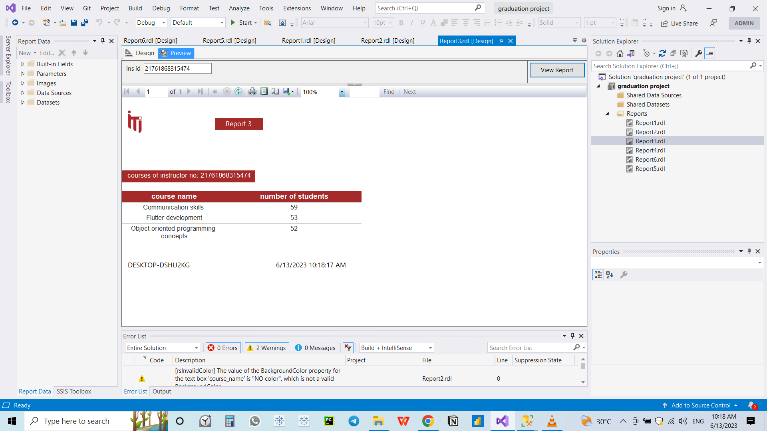
Number of Students By Instructor
Using Instructor ID this report display the number of students for each course the instructor teaches

Slide 20

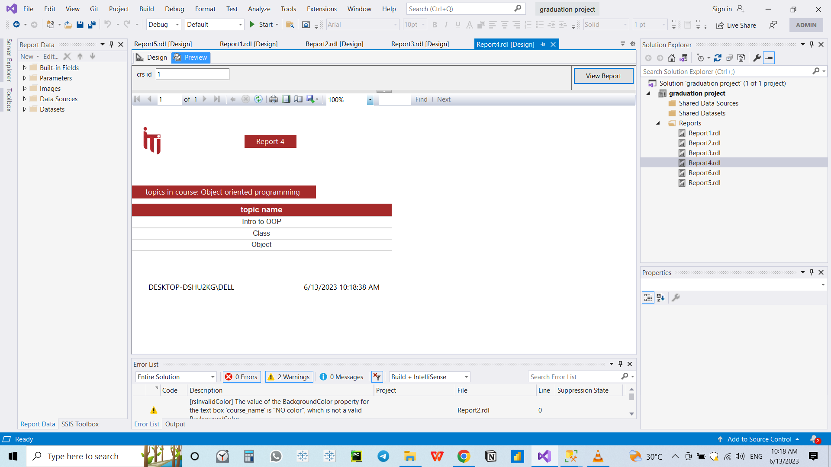
Topics in Course
Using Course ID this report display the number and names of each topic included in this course

Slide 21
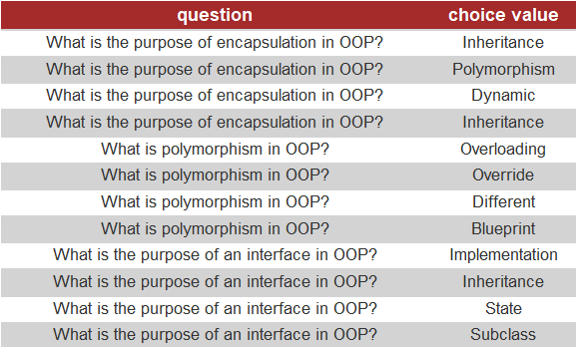
Choices For Question
Using exam ID this report display each question with its choices

Slide 22
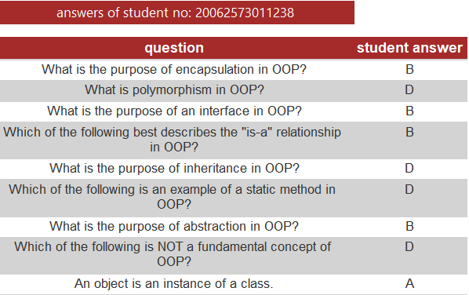
Student Answer By Question
Using Exam ID and Student ID this report display each question with the answer of the student

Slide 23
DASHBOARDS

Slide 24
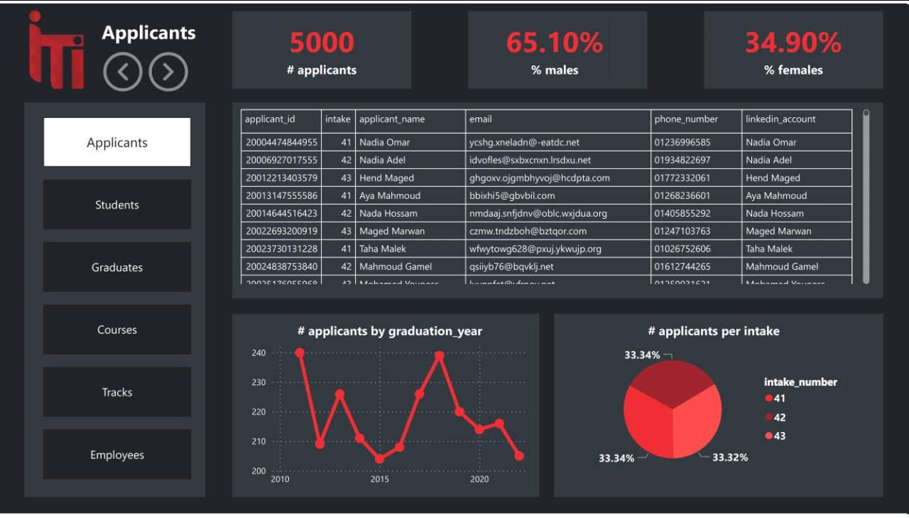

Slide 25
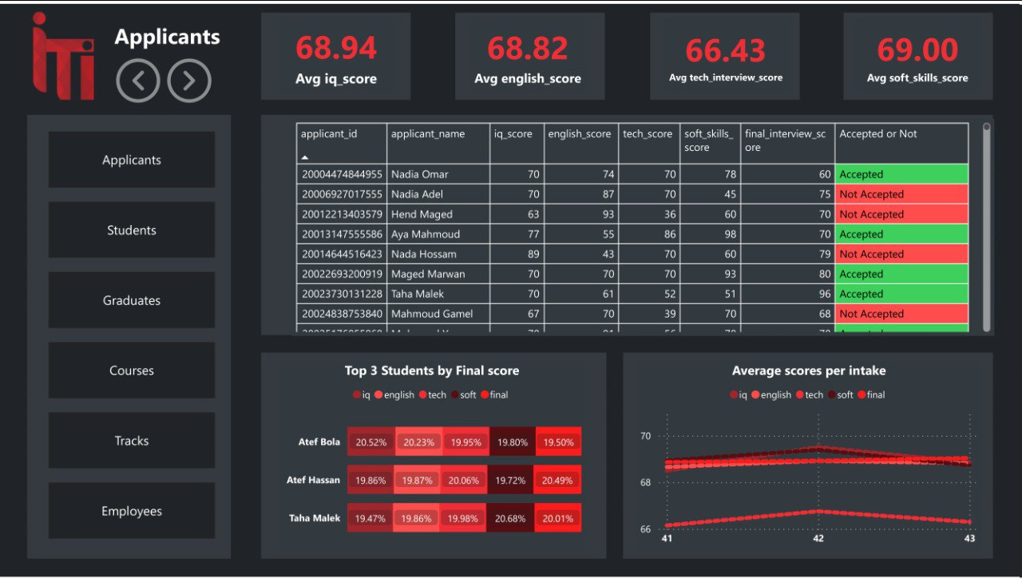

Slide 26
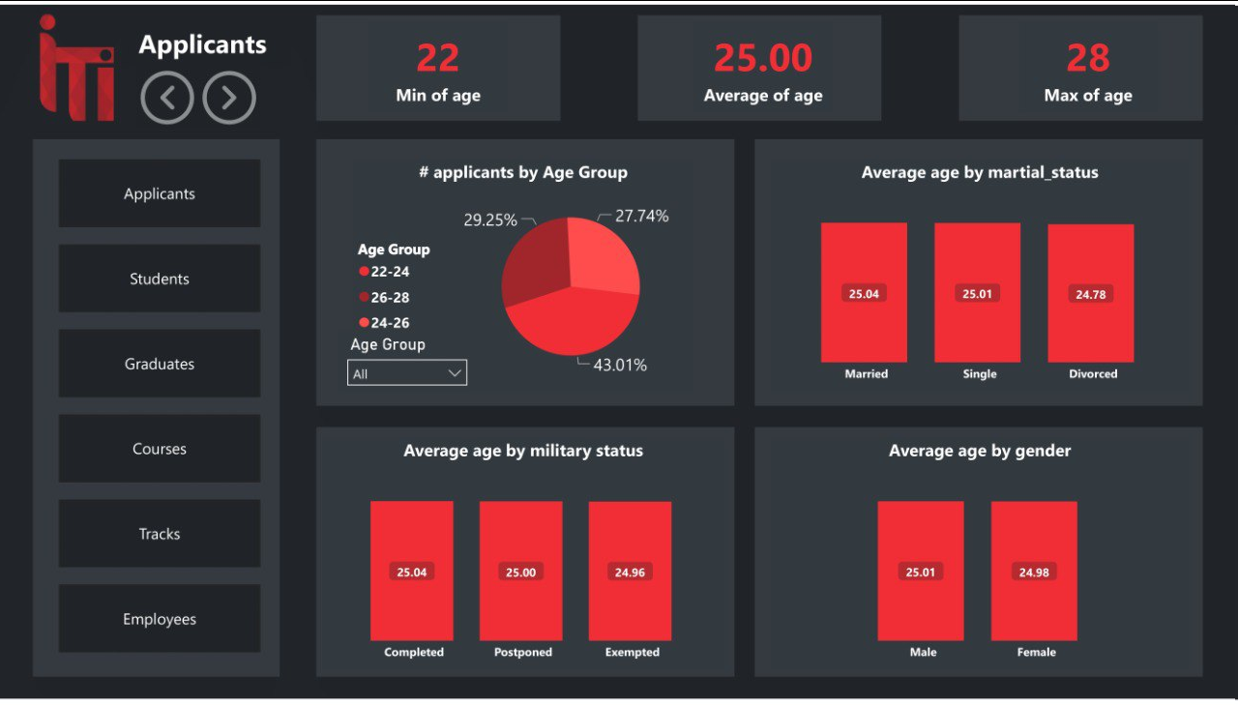

Slide 27
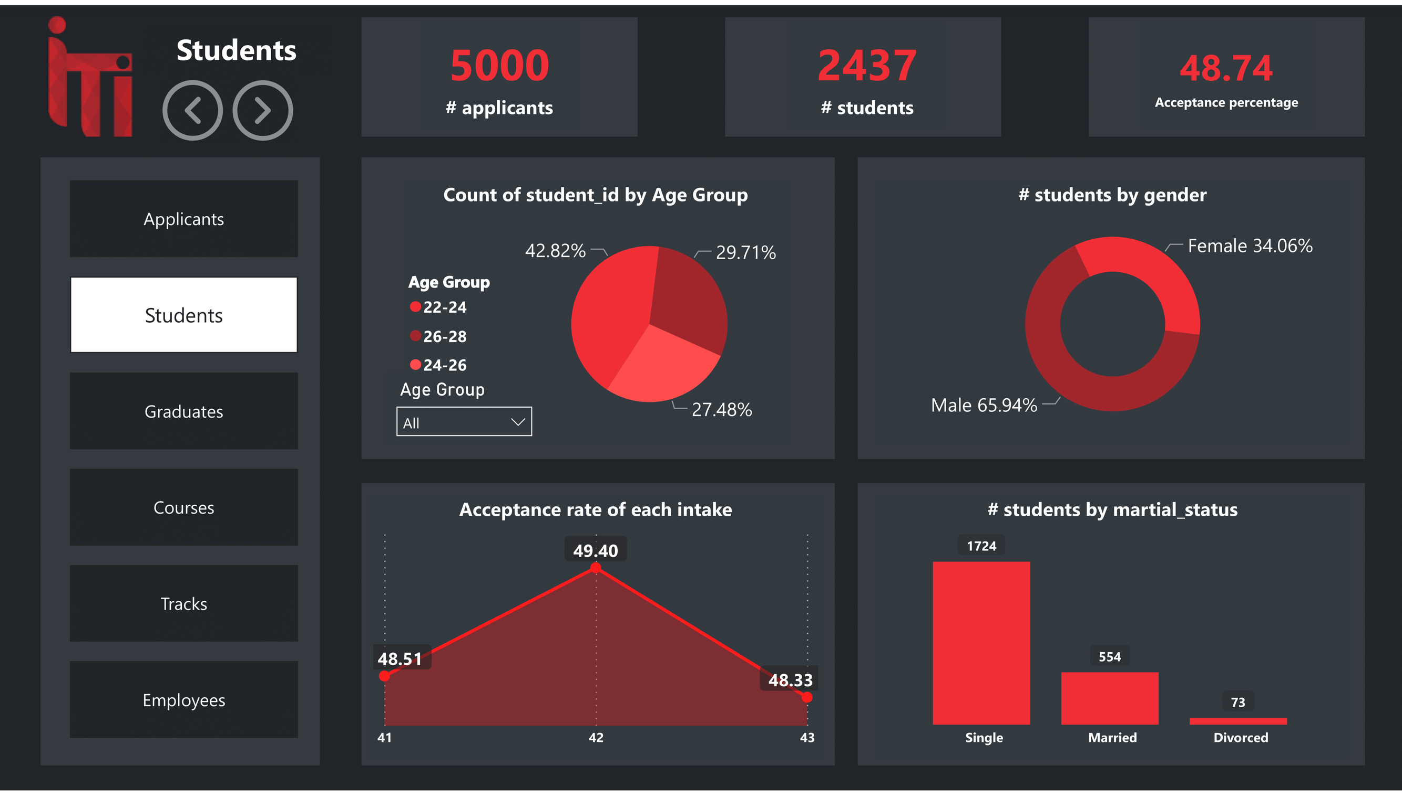

Slide 28
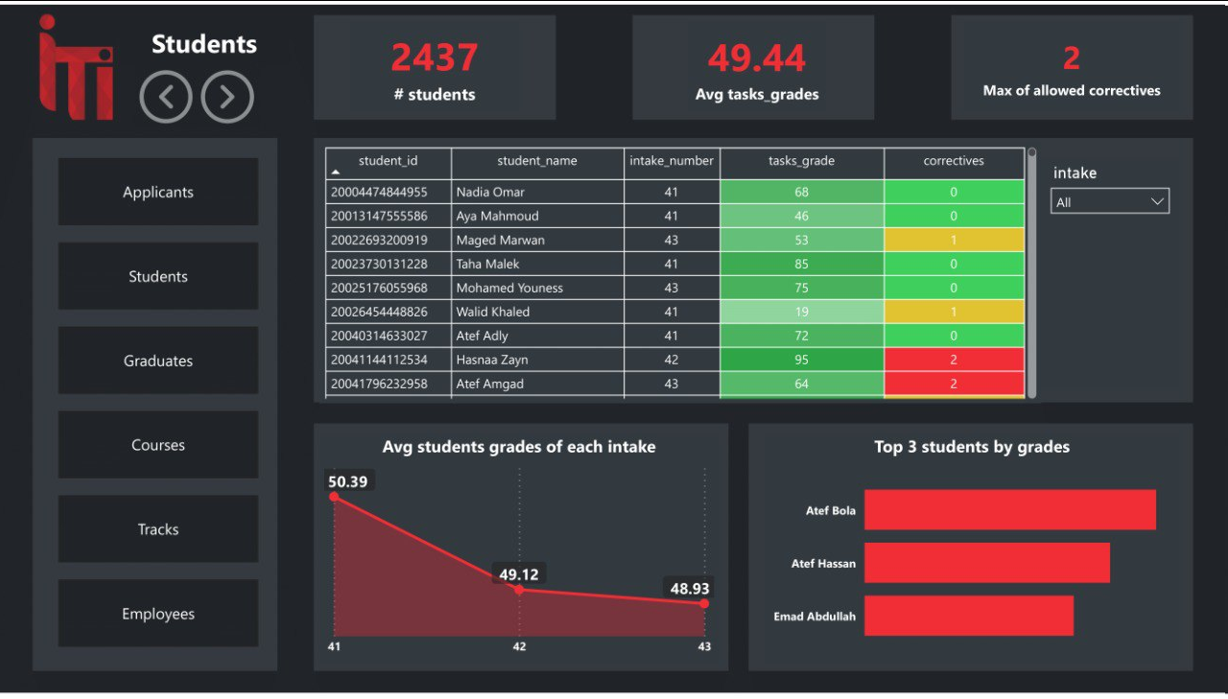

Slide 29
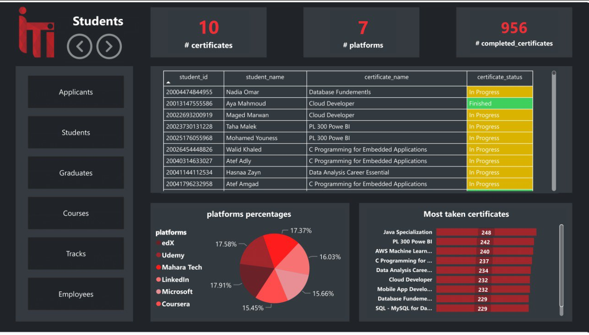

Slide 30
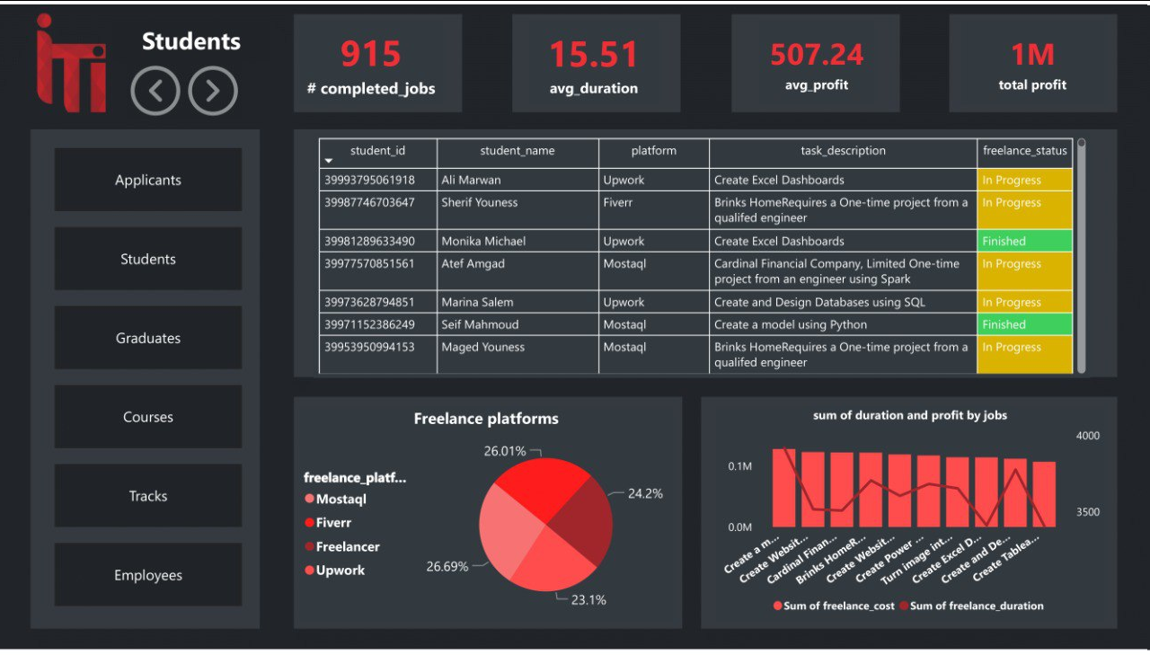

Slide 31
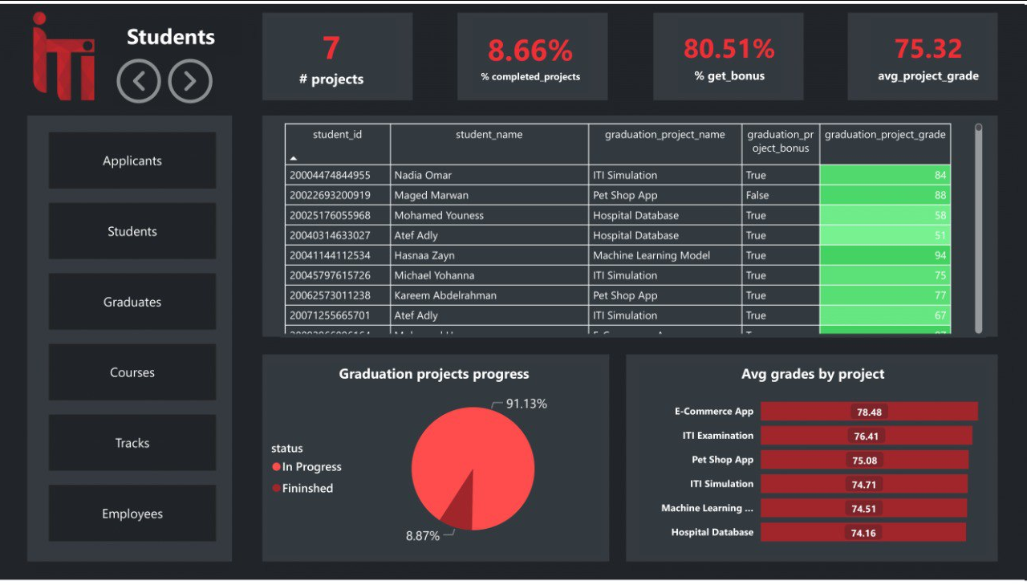

Slide 32
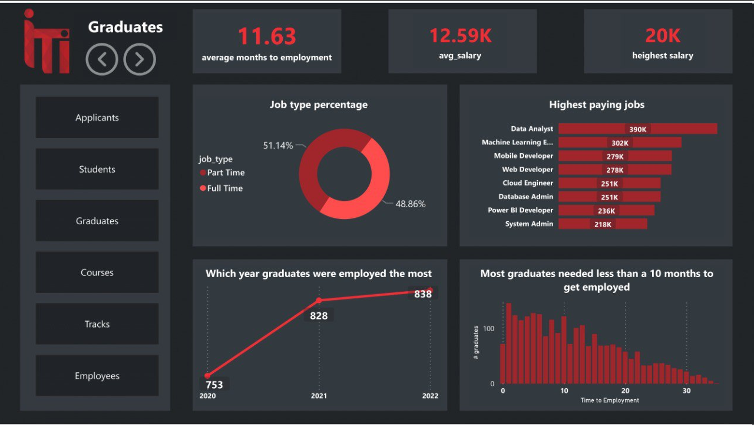

Slide 33
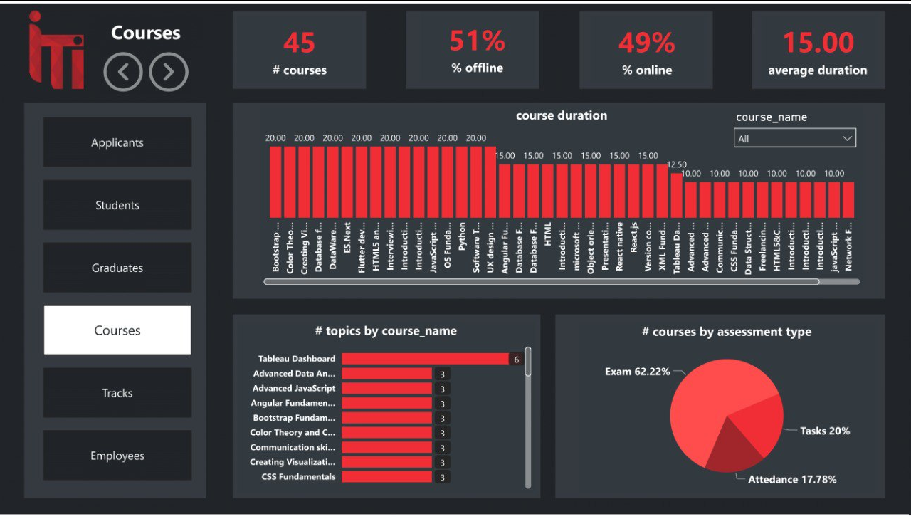

Slide 34
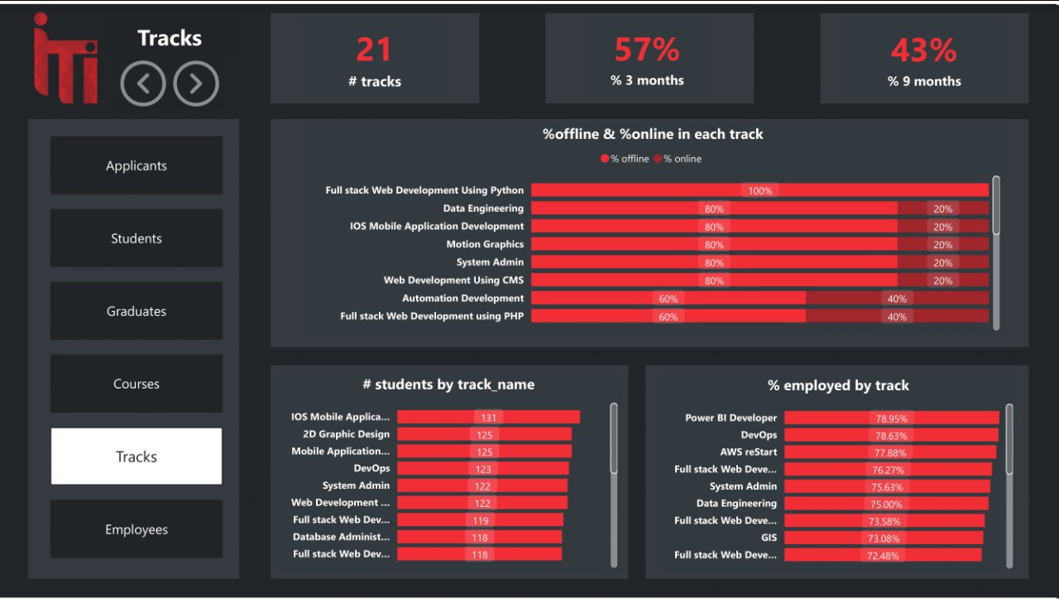

Slide 35
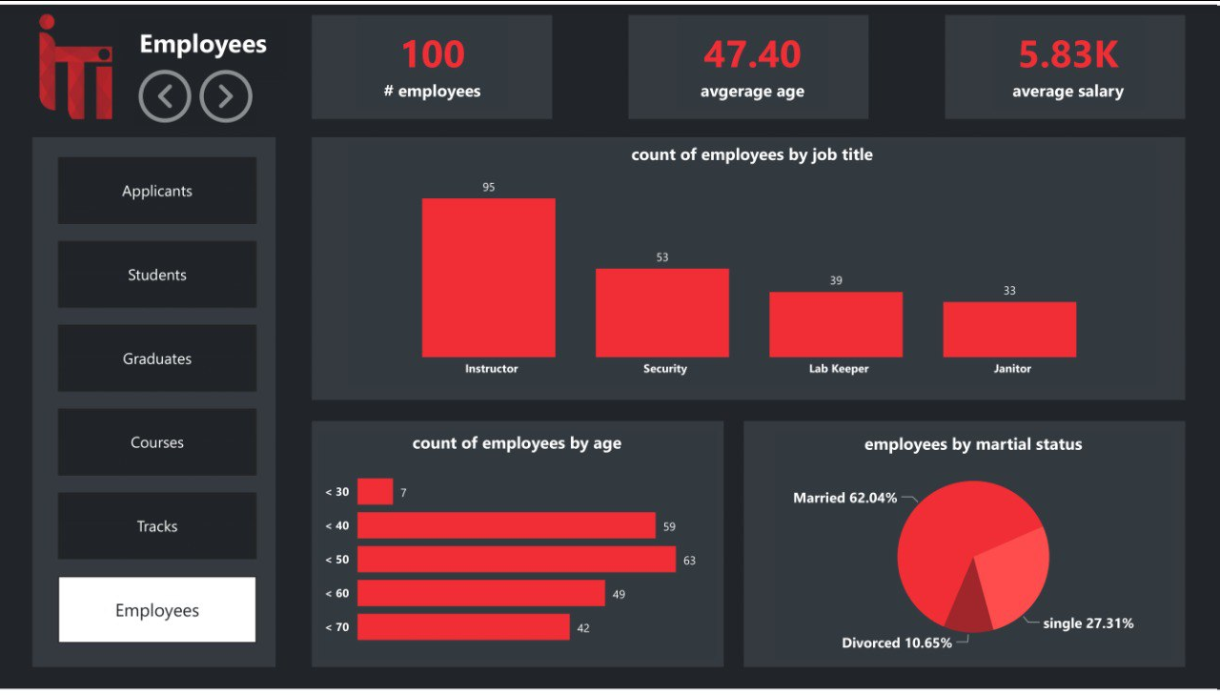

Slide 36

ANY QUESTIONS?
LARANA, INC.

Slide 37
THANK
YOU
LARANA, INC.

